Slide 1


VISVESVARAYA TECHNOLOGICAL UNIVERSITY “Jnana Sangama” Belagavi – 590018 Sir M Visvesvaraya Institute Of Technology,Bengaluru-56257 DEPARTMENT OF ELECTRONICS AND COMMUNICATION ENGINEERING Mini Project Presentation on PCB DEFECT DETECTION USING IMAGE PROCESSING
Presented by
G PAVITHRAN (1MV20EC047)
GAGANA R (1MV20EC048)
KAMYASHREE T (1MV20EC059)
LAKSHITHA G (1MV20EC064)
Under the Guidance of
Dr. V G SUPRIYA
PROFESSOR & HOD
ECE DEPARTMENT

Slide 2
Contents
INTRODUCTION
LITERATURE SURVEY
OBJECTIVES
HARDWARE DETAILS
SOFTWARE DETAILS
RESULTS AND OUTCOMES
MERITS AND DEMERITS
CONCLUSION AND FUTURE SCOPE
REFERENCES

Slide 3
INTRODUCTION
Printed circuit board (PCB) fabrication process is a multidisciplinary process, and etching is the most critical part in the PCB manufacturing process.
Etching is the process, where the copper board will undergo ‘peeling’ process, where the circuit layout will be preserved while the rest of the copper background will be washed out. In order to minimize scrap caused by the wrongly etched PCB panel, inspection has to be done in early stage.
The traditional way to inspect any defect is visually employing human operators, this process is not only time consuming but also highly prone to errors due to human’s factors.

Slide 4
The next trend then is to use machine vision inspection system. However, all of the inspections are done after the etching process where any defective PCB found is no longer useful and is simply thrown away.
Since etching process costs 70% of the entire PCB fabrication, it is uneconomical to simply discard the defective PCBs.
Hence, this project proposes an automatic visual inspection on the PCB before the etching process so that any defect that could be found on a PCB would be able to be reprocessed. Although many algorithms are available in defect detection, both contact and non contact methods none is able to classify these defects.

Slide 5
LITERATURE SURVEY
Ismail Ibrahim, Syed Abdul Rahman Syed Abu Bakar, Musa Mohd Mokaji, Jameel Abdulla Ahmed Mukred, Zulkifly Md Yusof, Zuwairie Ibrahim, Kamal Khalil, Mohd Saberi Mohamad
To reduce the cost, the bare PCBs should be inspected before PCB manufacturing.In mass production of PCBs, the inspection of PCB is necessary, especially for high level complexity of boards.*There are different methods for inspection of PCB.
A individual operator inspect defect by looking at board in a manual inspection.
But this method was yielding a poor results. In research works mentioned in paper by Ismail Ibrahim and others Automatic optical inspection is preferred method for inspection of PCB.
An automated visual printed circuit board (PCB) inspection is used to reduce problems occurred due to manual inspection.

Slide 6
LITERATURE SURVEY
Wu, Wen-Yen, Mao-Jiun, J. Wang and Chih-Ming, Liu
PCB defects can be categorized into two groups: functional defects and cosmetic defects.
Functional defects can seriously affect the performance of the PCB or cause it to fail.
Cosmetic defects affect the appearance of the PCB, but can also jeopardize its performance in the long run due to abnormal heat dissipation and distribution of current.
There are 14 known types of defects for single layer, bare PCB. For instance, the work carried out by Wen-Yen, did the direct subtraction of the reference to the test image to produce Positive (P), Negative (N) and Equal (E) pixels.
Defects detected on P and N pixels. After that, defect classification is done based on P, N and E pixels.

Slide 7
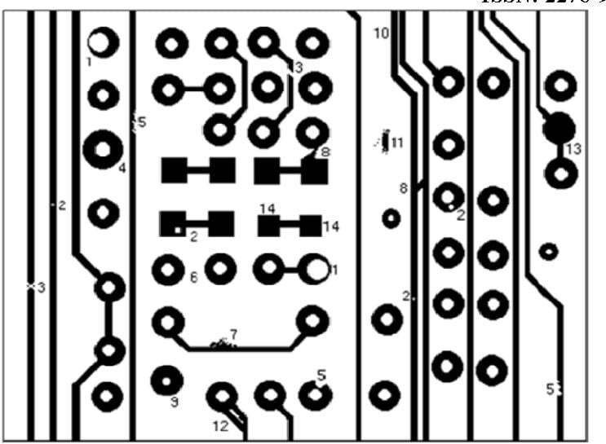
LITERATURE SURVEY
Malge P.S., Nadaf R.S.
Defect detection and classification and localization method explained in paper published by Malge, uses mathematical morphology and image processing tools. Besides the need to detect the defects, it is also essential to classify and locate these defects so that the source and location of these defects can be identified.

Slide 8
OBJECTIVES
Product quality: Defect detection during manufacturing processes is a vital step to ensure product quality. The timely detection of faults or defects and taking appropriate actions are essential to reduce operational and quality-related costs. The quality of PCBs will have a significant effect on the performance of many electronic products.
Cost: In order to reduce cost spending in manufacturing caused by the defected bare PCB, the bare PCB must be inspected. The technology of computer vision has been highly developed and used in several industry applications. One of these applications is the automatic visual inspection of PCBs. The automatic visual inspection is important because it removes the subjective aspects and provides fast and quantitative assessments.
Human Error: One of the important objective of the project is to reduce the human error and produce error free components. The methodology stated in this project will reduce the human error and assures defect free products

Slide 9
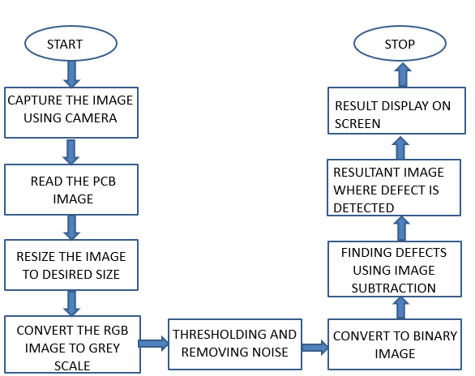
METHODOLOGY

Slide 10
HARDWARE DETAILS
Web Camera SIFI Pro:
Build-in image compression, Automatic brightness adjustment, Automatic colour compensation, Manual focus High resolution CMOS colour sensors, Large window capture size: 640X480/800X600 Auto focus computer camera captures HD video at a wide-angle of up to 90 degrees, PC or laptop with USB port Pentium 200 or higher CPU, Operation system. Windows XP/ 2000 /2003 / Vista 71 B/ 10, Mac OS, Android and Linux. Fixed regular 60cm focal length, you can freely rotate the lens to adjust.
Webcam Holder:
Adjustable stand, Compatible with all webcams, Product length is 29.5 inch in total and high- quality solid Iron metal makes product sturdy enough to hold webcam firmly.
PCBs:
Printed circuit board is a medium used to connect electronic components to one another in a controlled manner. It takes the form of a laminated sandwich structure of conductive and insulating layers, each of the conductive layers is designed with an artwork pattern of traces, planes.
Tracks carry the electrical signals and they are in fixed positions.

Slide 11
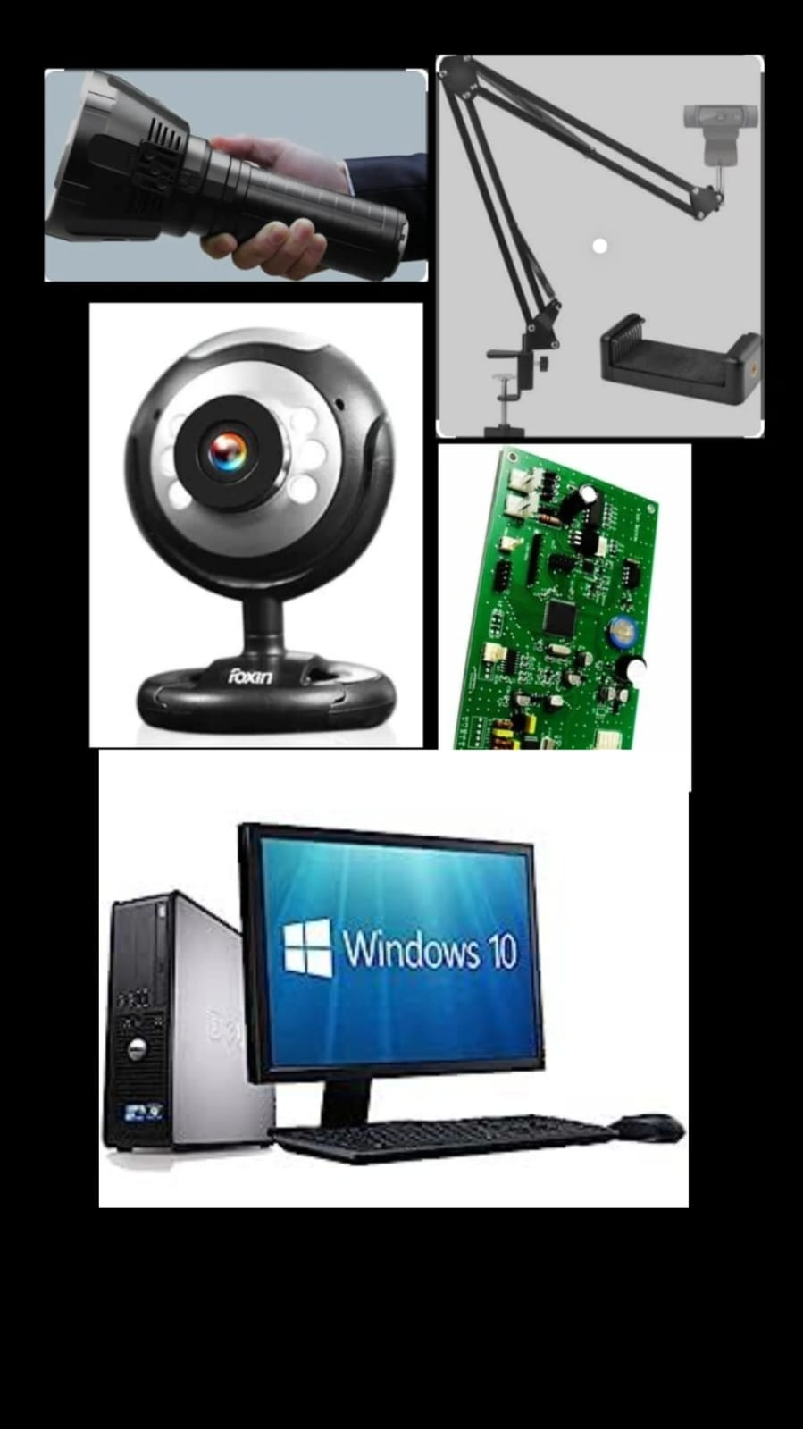
COMPUTER WITH MATLAB INSTALLED :
OPERATING SYSTEMS
Windows 11, Windows 10 (version 1909 or higher), Windows 7 Service Pack 1, Windows Server 2019, Windows Server 2016
PROCESSOR
Minimum: Any Intel or AMD x86-64 processor,
Recommended: Any Intel or AMD x86-64 processor with four logical cores and AVX2 instruction set support
DISK
Minimum: 3.4 GB of disk space for MATLAB only, 5-8 GB for a typical installation
Recommended: An SSD is recommended
Graphics
No specific graphics card is required.
Hardware accelerated graphics card supporting OpenGL 3.3 with 1GB GPU memory is recommended
RAM
Minimum: 4 GB
Recommended: 8 GB

Slide 12
SOFTWARE DETAILS
1.Image Acquisition Toolbox:
Image Acquisition Toolbox™ provides functions and blocks for connecting cameras to MATLAB®. it includes a MATLAB app that lets you interactively detect and configure hardware properties. The toolbox enables acquisition modes such as processing in-the-loop, hardware triggering, background acquisition, and synchronizing acquisition across multiple devices.
2.Image Acquisition Toolbox Support Package for OS Generic Video Interface: Image Acquisition Toolbox™ Support Package for OS Generic Video Interface enables you to acquire images and video, helps in device detection and configuration from DirectShow® (Windows®), GStreamer (Linux®), AV Foundation (Mac) video capture devices directly into MATLAB®

Slide 13
3.Image Processing Toolbox:
Image Processing Toolbox™ provides a comprehensive set of reference-standard algorithms and workflow apps for image processing, analysis, visualization, and algorithm development. The toolbox supports processing of 2D, 3D, and arbitrarily large images.
4. MATLAB Support Package for USB webcams:
With MATLAB® Support Package for USB Webcams, you can connect to your computer’s webcam and acquire images straight into MATLAB. Functionality is provided to preview live images, adjust acquisition parameters, and take snapshots either individually or in a loop.

Slide 14
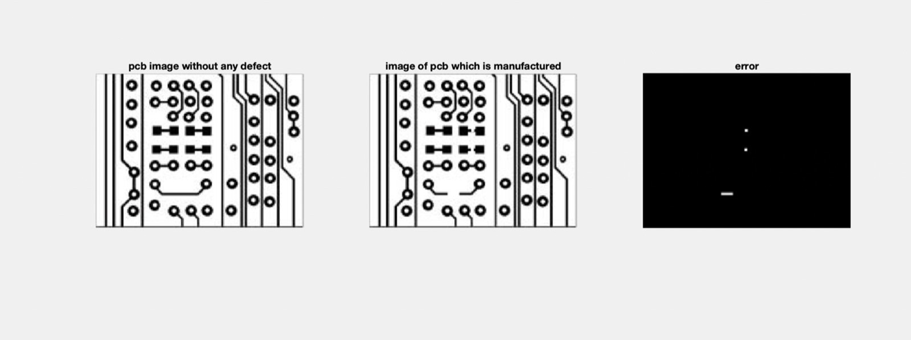
RESULTS AND OUTCOMES
The missing tracks was detected and displayed as a PCB defect

Slide 15
MERITS AND DEMERITS
MERITS
NON-CONTACT METHOD
HIGH SPEED AND EFFICIENCY
AUTOMATION
ACCURACY AND PRECISION
FLEXIBILITY
DEMERITS
LIGHTING CONDITIONS
BACKGROUND INTERFERENCE
IMAGE QUALITY
VARIATIONS IN PCB QUALITY
HIGH INITIAL CAPITAL INVESTMENT

Slide 16
CONCLUSION AND FUTURE SCOPE
CONCLUSION:
THE PCB WERE TESTED AND PCB DEFECTS WERE DETECED USING IMAGE PROCESSING AND THE RESULT IS DISPLAYED
FUTURE SCOPE
ADVANCED DEFECT DETECTION
3D PCB INSPECTION
AUTOMATED OPTICAL INSECTION
INTELLIGENT PCB TRACEABILITY
ROBOTICS AND AUTOMATION
AUGMENTED REALITY ASSISTANCE

Slide 17
REFERENCES
[1] Ismail Ibrahim, Syed Abdul Rahman Syed Abu Bakar, Musa Mohd Mokaji, Jameel Abdulla Ahmed Mukred, Zulkifly Md Yusof, Zuwairie Ibrahim, Kamal Khalil, Mohd Saberi Mohamad, “A Printed Circuit Board Inspection System with Defect Classification Capability,” International Journal of Innovative Management, Information & Production, Volume 3, Number 1, pp. 82-87, March 2012.
[2] Wu, Wen-Yen, Mao-Jiun, J. Wang and Chih-Ming, Liu. “Automated Inspection of Printed Circuit Boards Through Machine Vision.” 1996 Computers in Industry. Vol. 28. Issue 2. 103 – 111.
[3] Sanveer Singh, Manu Bharti, “Image Processing Based Automatic Visual Inspection System for PCBs,” IOSR Journal of Engineering (IOSRJEN) ISSN: 2250-3021 Volume 2, pp. 1451-1455, June 2012.
[4] Malge P.S., Nadaf R.S., “PCB Defect Detection, Classification and Localization using Mathematical Morphology and Image Processing Tools,” International Journal of Computer Applications (0975 – 8887), Volume 87, Number 9, February 2014.

Slide 18
THANKYOU

